Slide 1
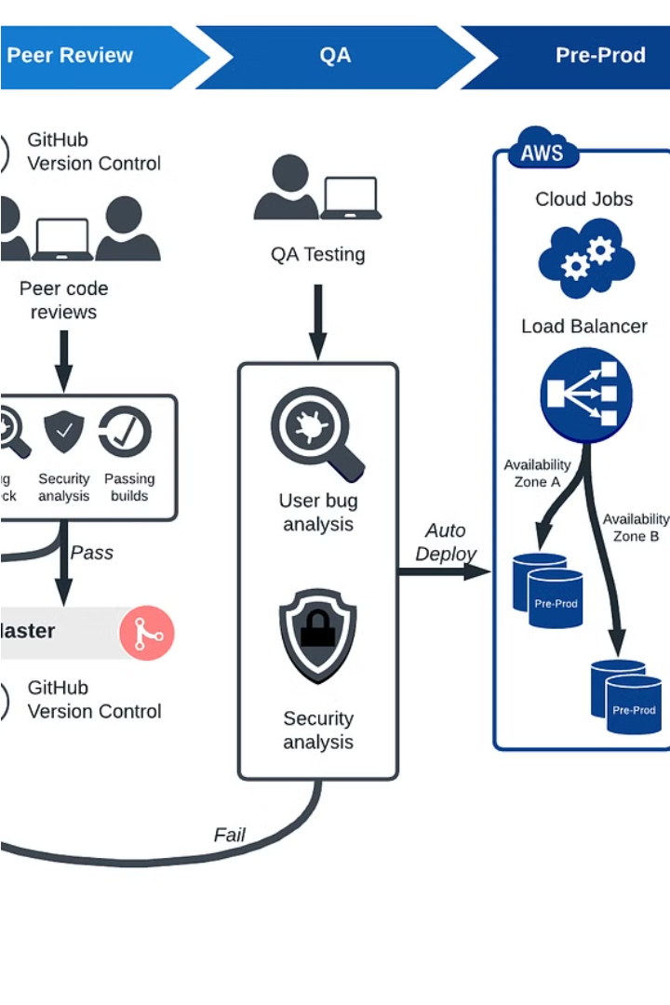
Automate DevOps Workflow
In this project, we'll set up a powerful DevOps pipeline by provisioning virtual machines, automating user management, and configuring Jenkins to monitor a GitLab repository for seamless code integration and deployment.
by Ahmed Ansary
aa

Slide 2
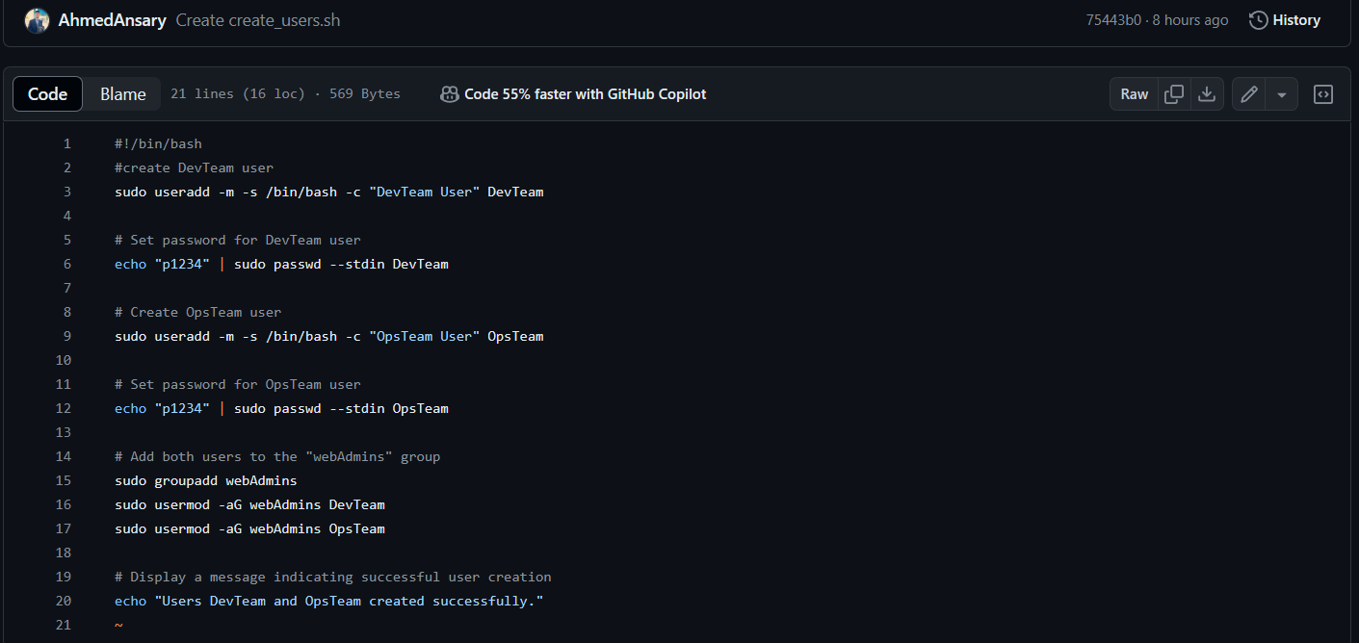
User Management on VM3

Slide 3

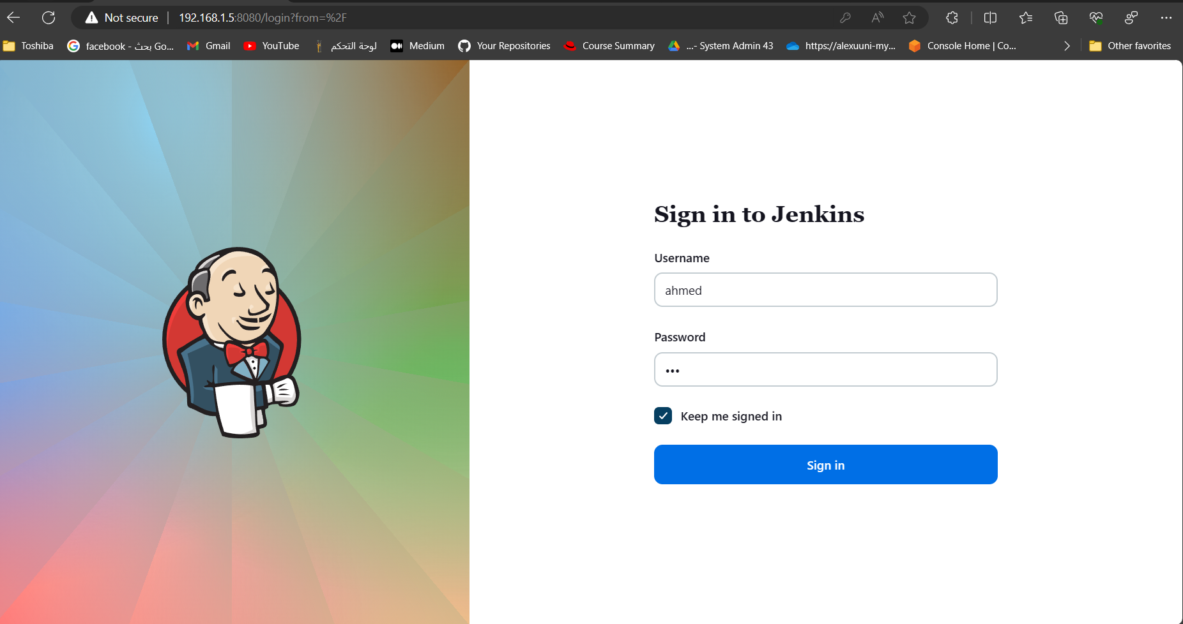
Install and Configure Jenkins (VM1)
Install Jenkins, a popular open-source automation server, on VM1 to automate the software development lifecycle.

Slide 4
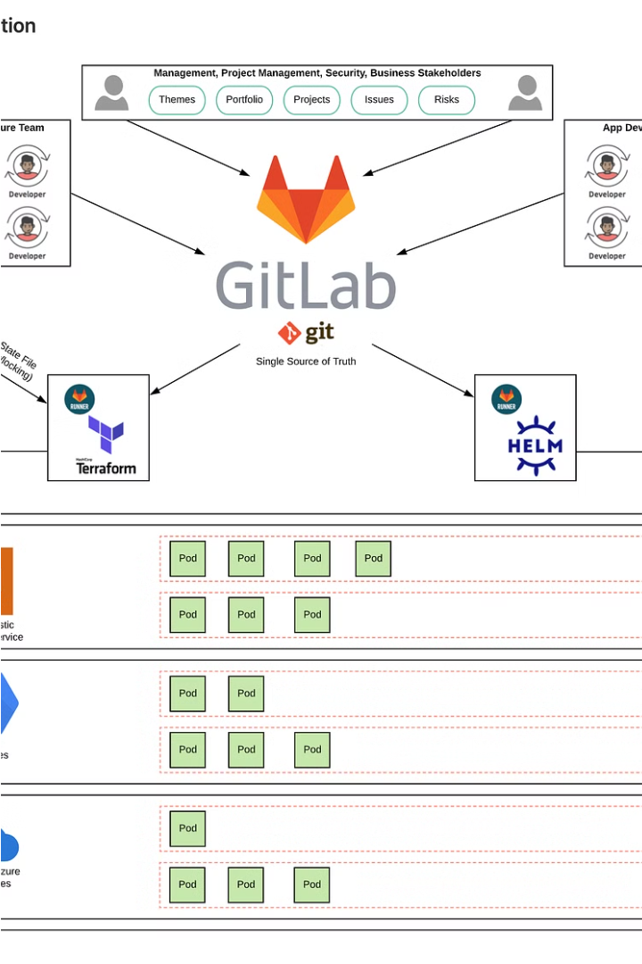
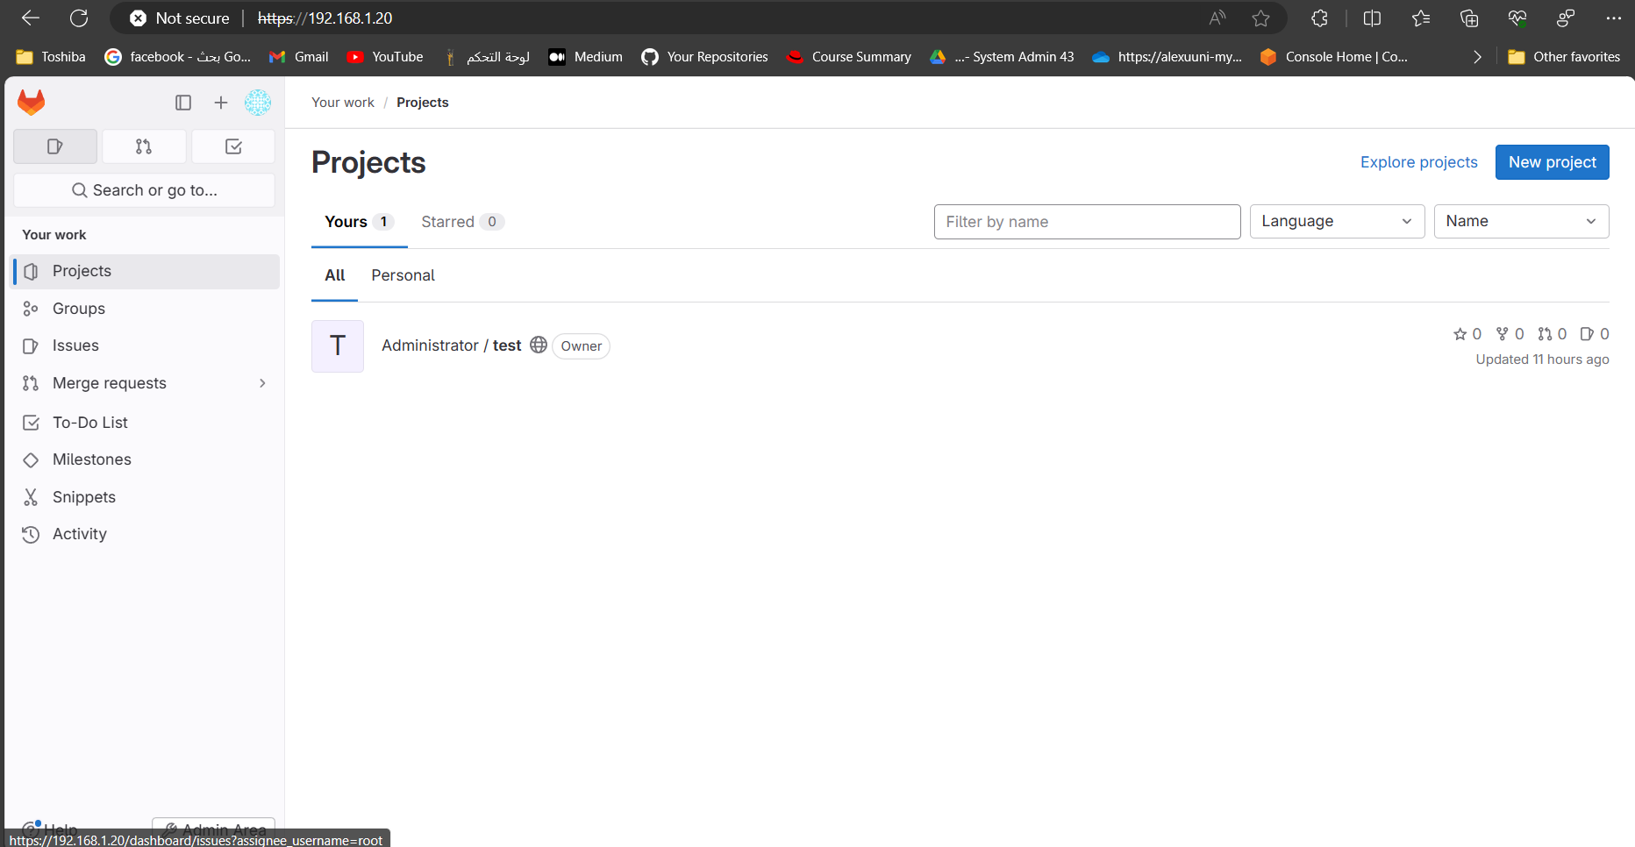

Install and Configure GitLab (VM2)

Slide 5

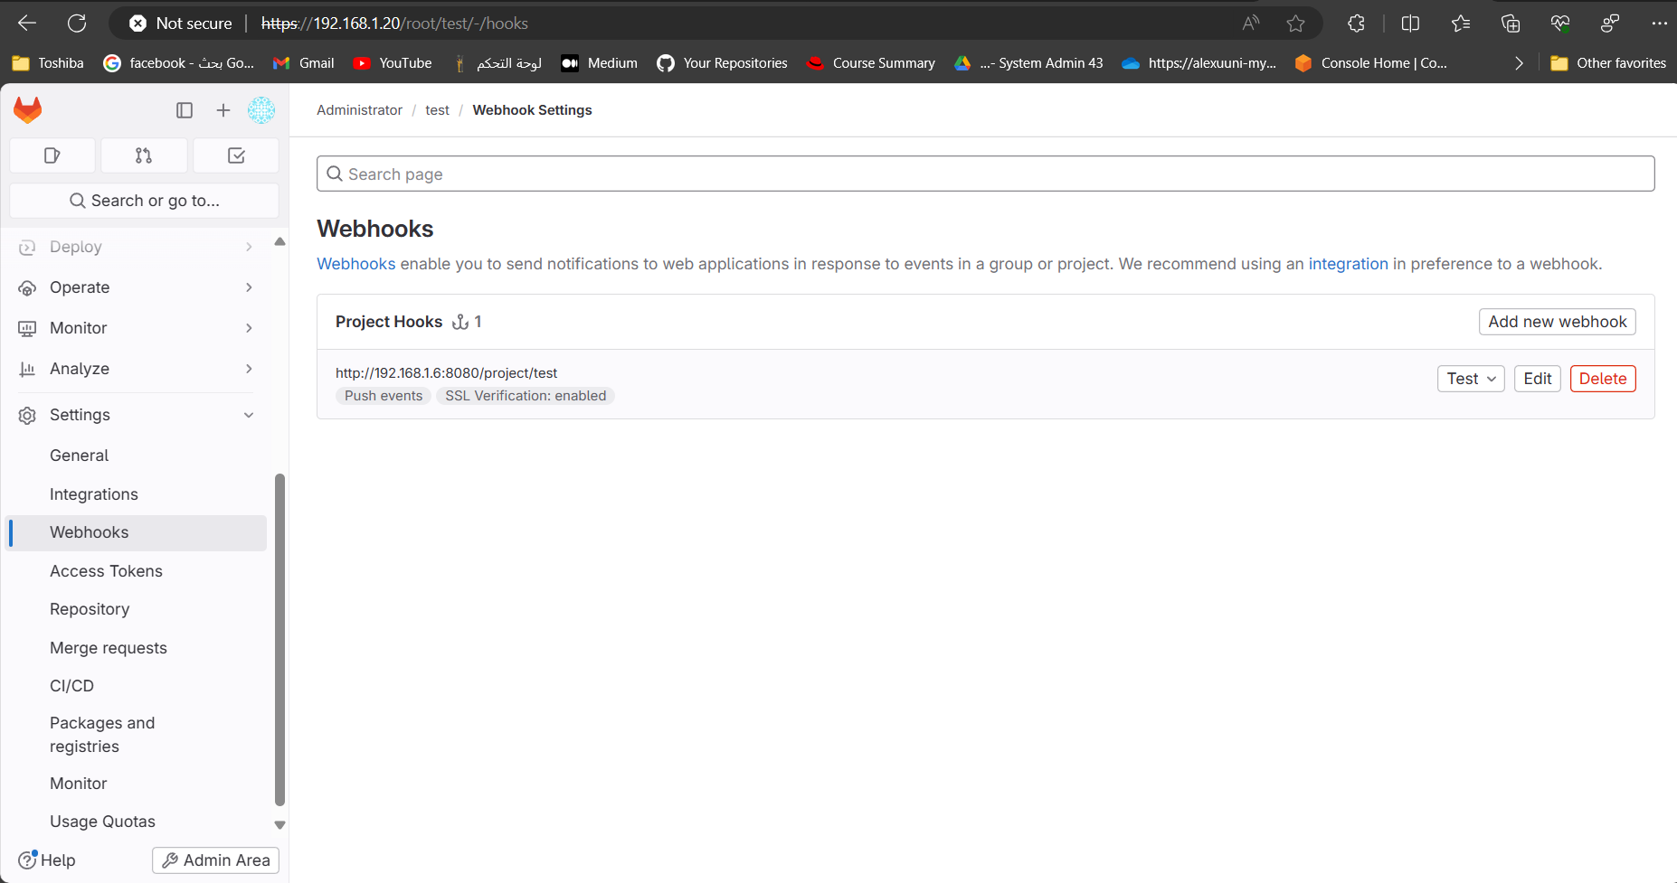



Configure GitLab Integration with Jenkins
Install Plugins
.
Configure Webhook
Automate Builds

Slide 6

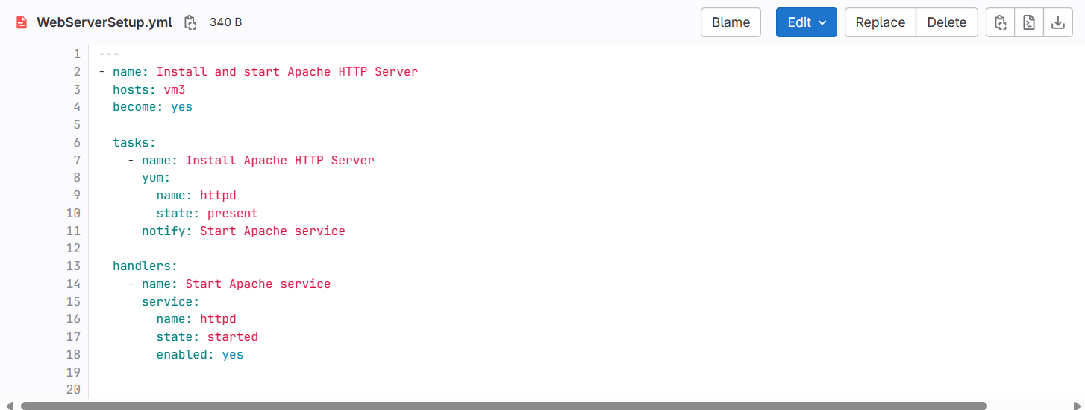
Develop Ansible Playbook (VM3)

Slide 7
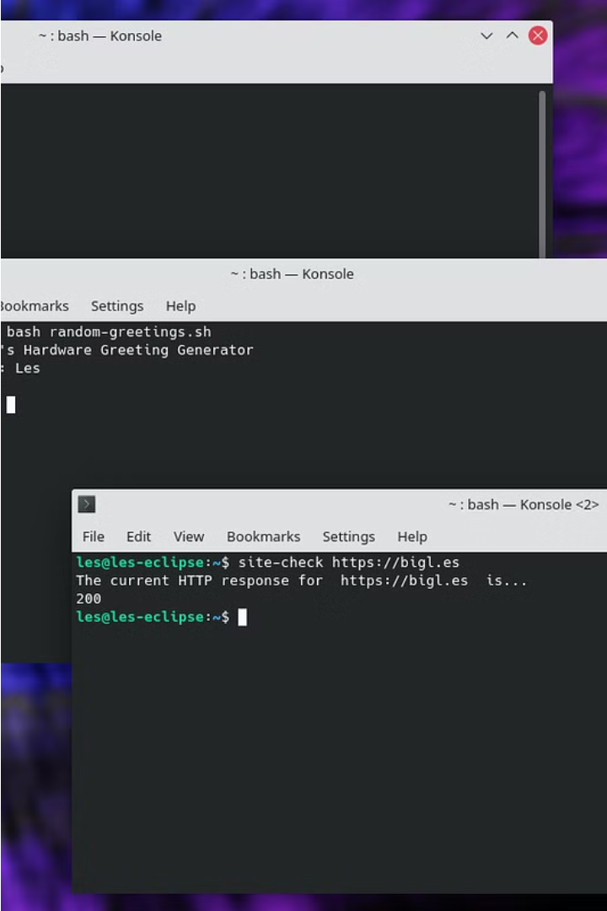
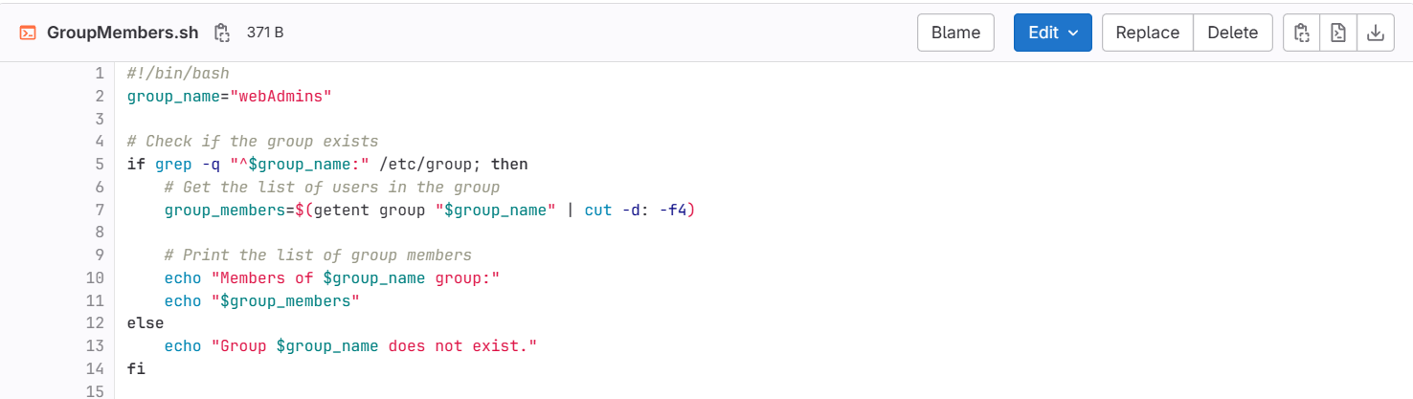
Write Bash Script (VM3)
To fetch a list of users from the "webAdmins" group on VM3, the DevOps team will create a Bash script called "GroupMembers.sh". This script will leverage Linux system commands to retrieve the group membership information and output it in a clean, readable format.

Slide 8
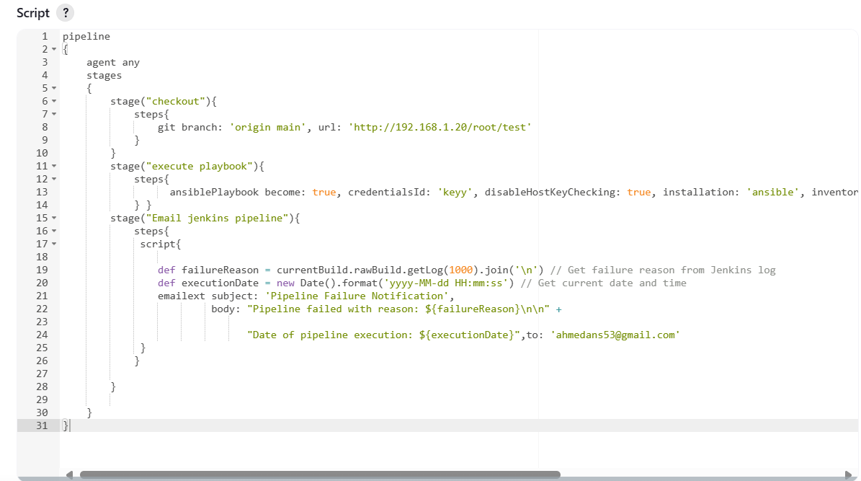
CI/CD Pipeline Configuration

